Slide 1
APIARY DATA SERVICES
Anti-Theft Device

Slide 2
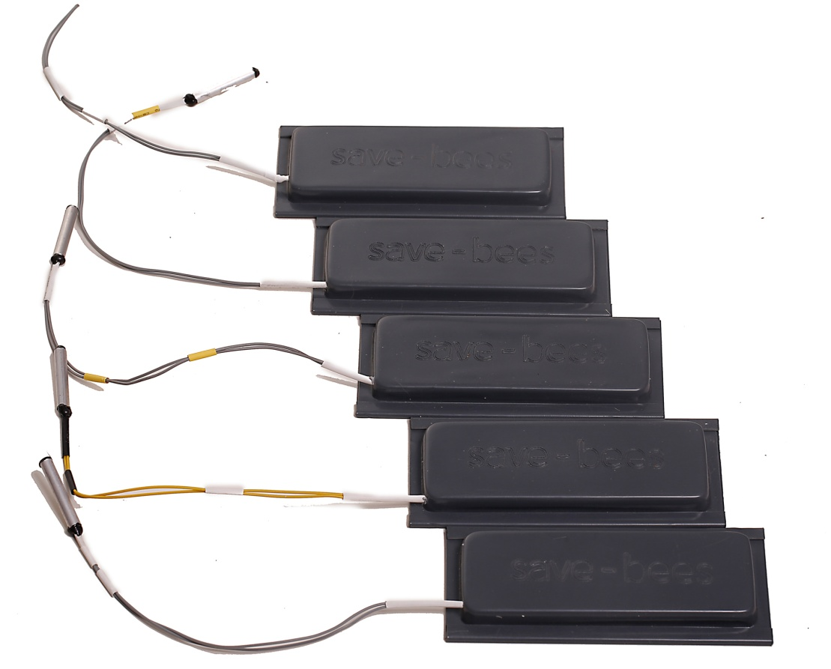
Introduction
Save-bees’ Anti Theft Device helps professional beekeepers to locate their hives in cases of theft or unexpected relocations.
It can inform the beekeepers about the accurate location of their beehives, with the usage of GPS integration and SMS messages via your local network provider.

Slide 3
Competitive advantages
Energy saving design, up to three months of battery mode operation.
Friendly to the bees operational services, it does not emit any harmful radiation.
Small size, easy to install.
Undetectable to thieves.
The beekeepers save time and money by remotely checking the location of their
hives.

Slide 4
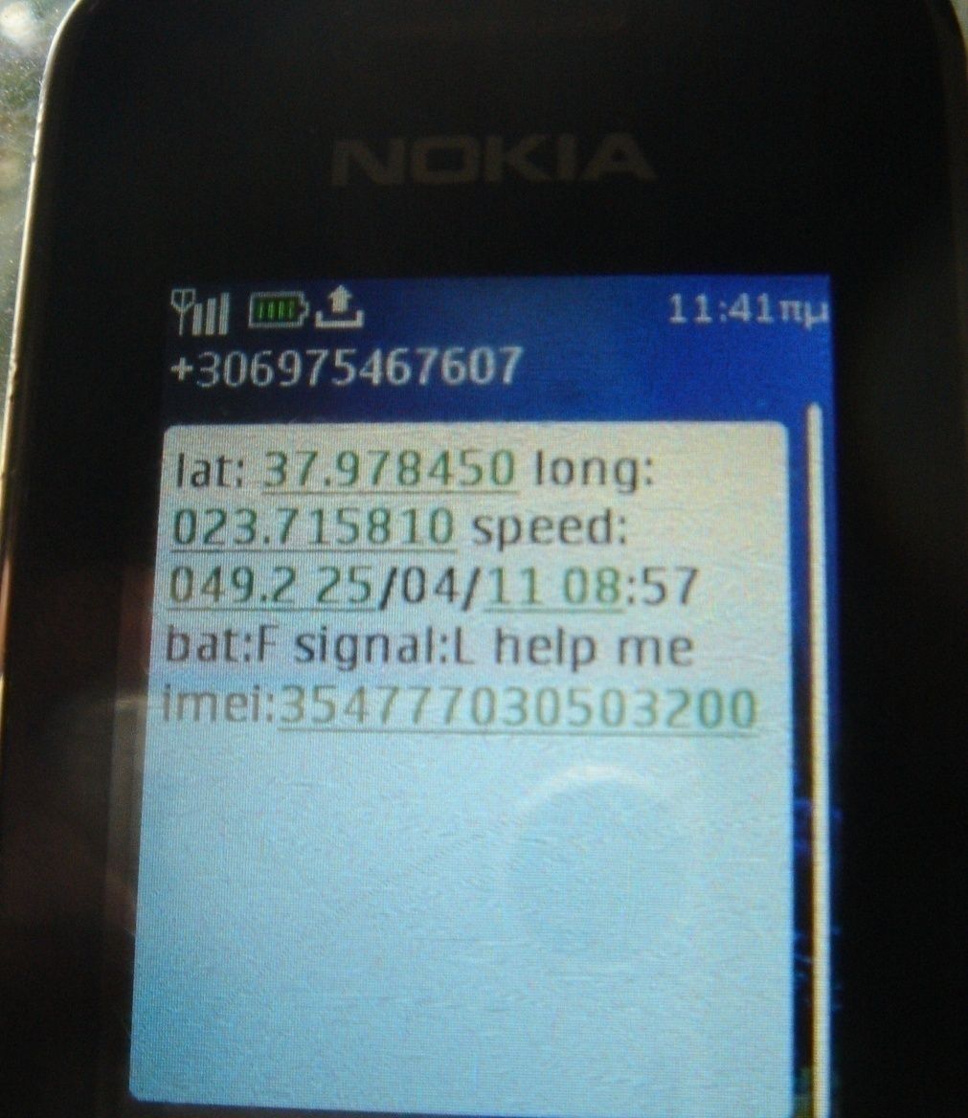
Key Features
The Anti-Theft device runs on “Lazarus” mode, it turns on only when its sensors pick up an unexpected relocation of the hive.
When activated, it sends two “Help” SMS messages containing the exact coordinates of your hive, via your local network provider.
It can be remotely turned off, in cases of false alarm triggering.
The Anti-Theft device can be disabled manually, during a hive inspection.

Slide 5
How does it work
Save-Bees’ Anti Theft device runs on Lazarus mode. It turns on only when its sensors pick up any kind of unusual relocation or activity.
The device operates with a standard GSM card. When the device activates, it sends two SMS “Help” messages containing :
The geographical coordinates of the hive (longitude, latitude)
The hive’s moving speed
The exact time of the hive relocation
The remaining battery level of the Anti-Theft Device

Slide 6
How does it work
Once the device is activated, the beekeepers can be informed about their hive’s current position by calling the hive’s GSM number through their mobile phones and receiving the hive’s exact coordinates via SMS message.
Even in cases of limited network coverage, the beekeepers can still be informed about the hive’s current position, once the device gets back within network coverage.
The Save-Bees’ Anti Theft device can also be remotely shut down in cases of false alarm triggering. For instance, if an animal accidentally hits into the hive and turns on the device, the beekeeper will be receiving SMS messages with the same, unaltered coordinates. Therefore, the beekeeper will be able to realize that the hive is not moving.

Slide 7
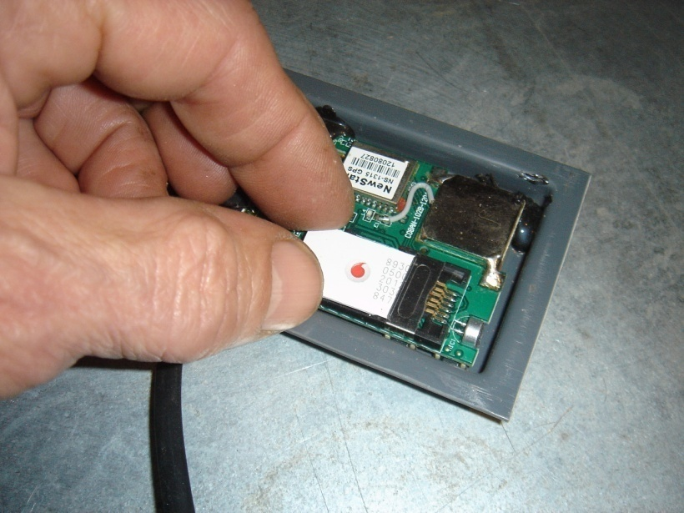
Installation Examples
Before you proceed with the installation of the Save-Bees’ Anti Theft Device into your hives, ensure that you have already installed a GSM card.
You can do that by simply opening the device and placing the GSM card into the GSM slot :

Slide 8
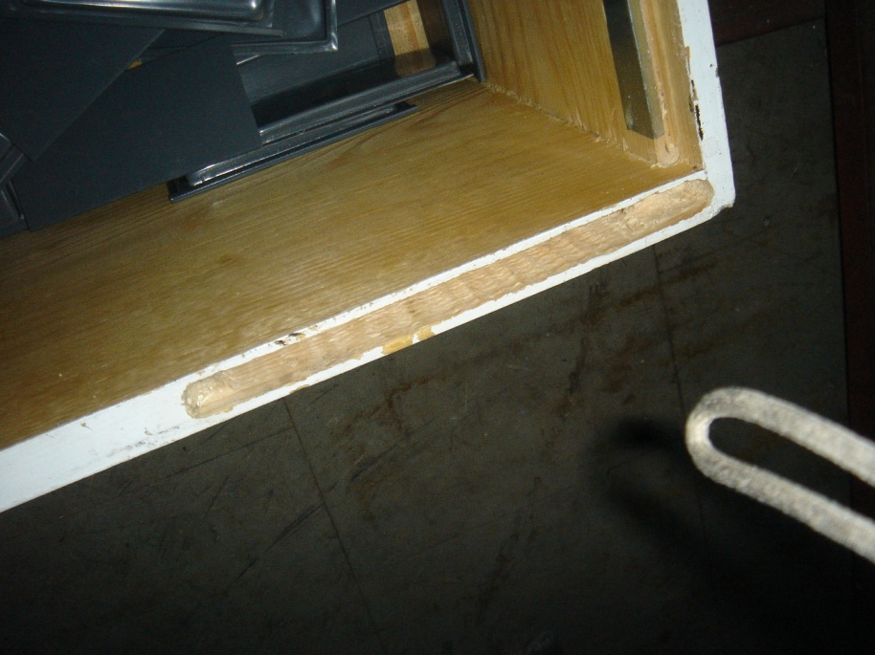
Installation Examples
Depending on the hive’s type (wooden, plastic), you can install the unit into your hive with separate ways.
The following pictures are actual installations of the Save-Bees’ Anti Theft Device, into different hive types.
Carved hole on the sides of a wooden hive

Slide 9
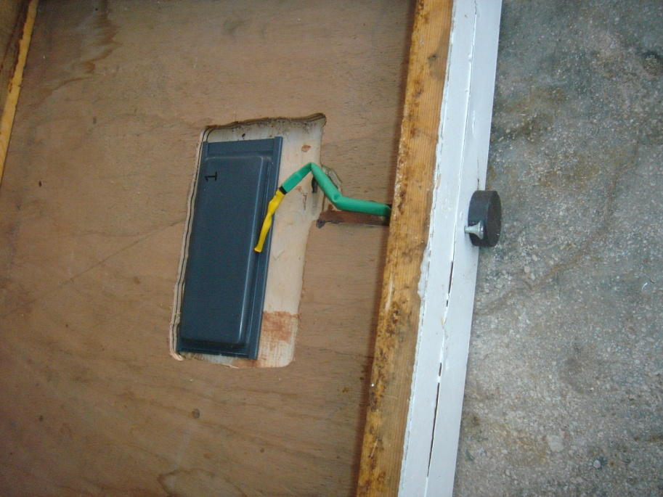
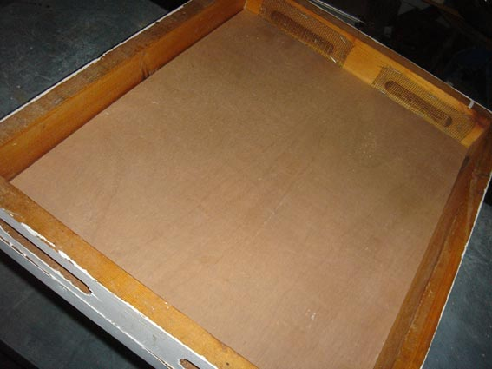
Installation Examples
Carved hole on the back of a wooden hive cover

Slide 10
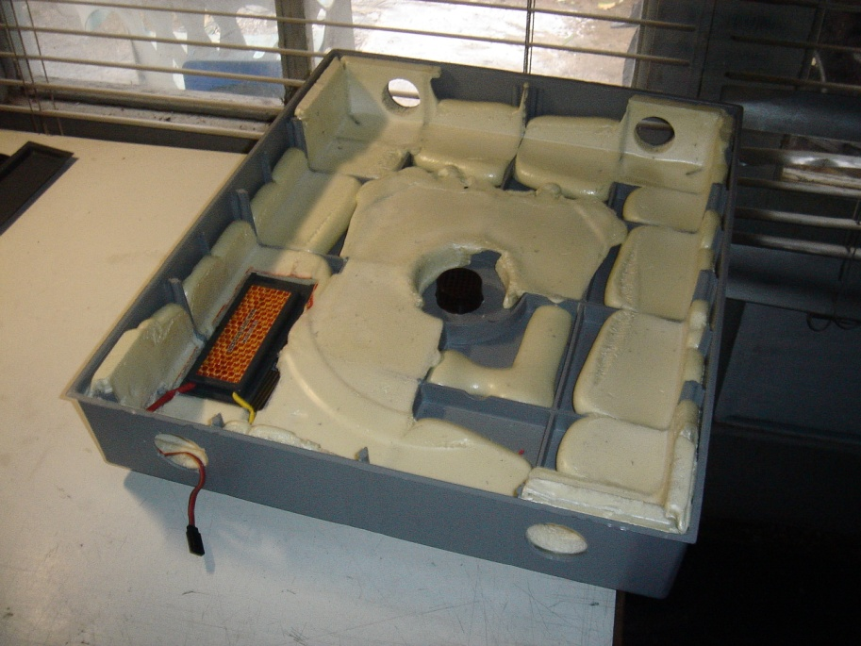
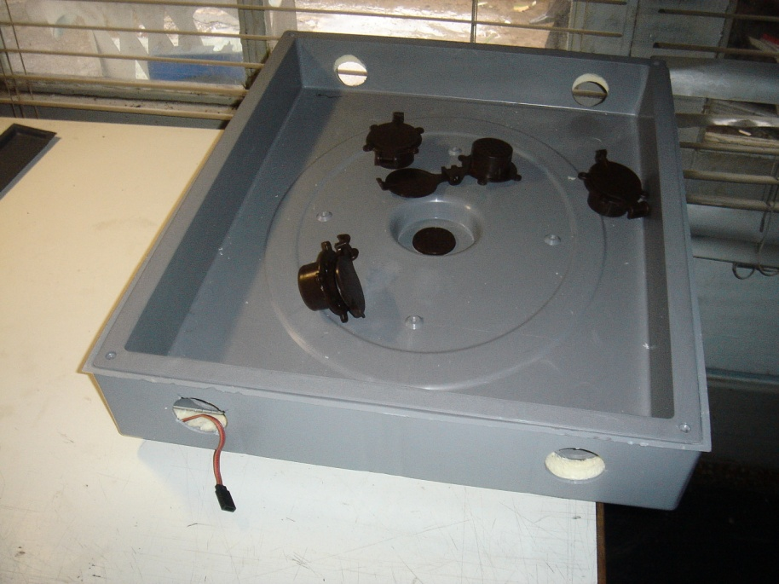
Installation Examples
Placed inside a plastic hive cover

Slide 11
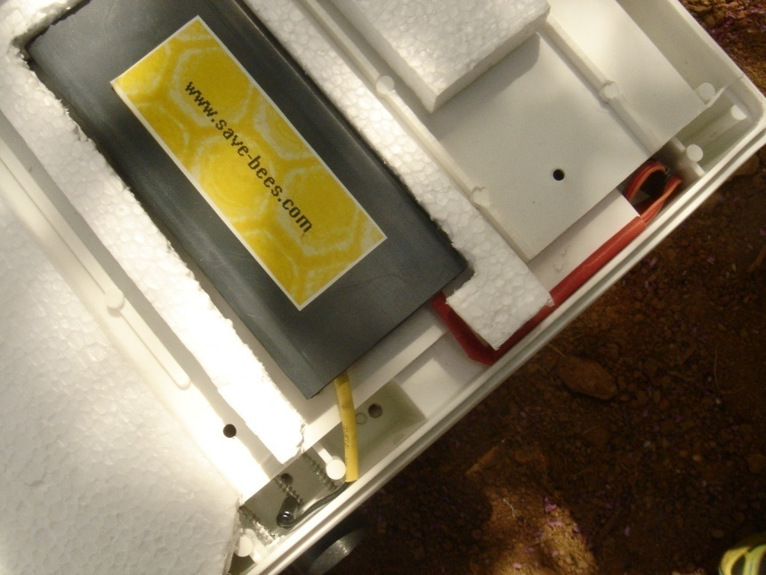
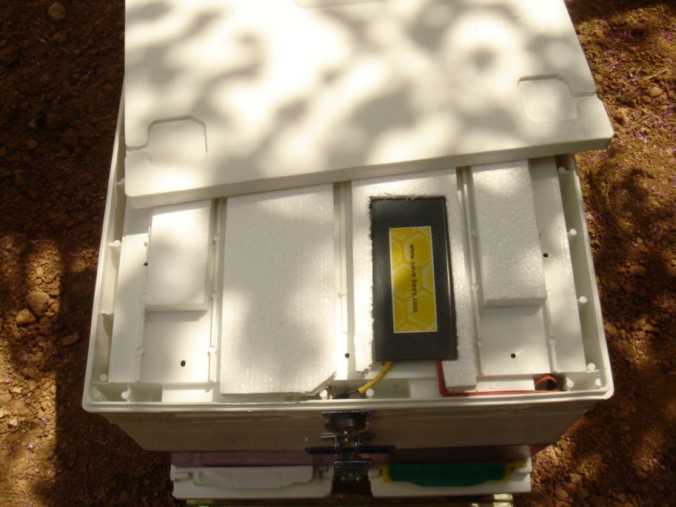
Installation Examples
Placed inside a plastic hive cover

Slide 12
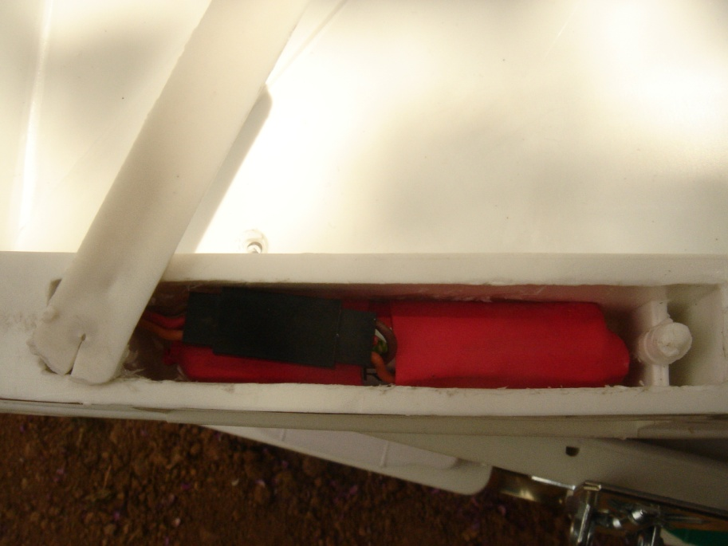
Installation Examples
The Anti-Theft device’s battery can be placed separately into a plastic hive, so that the beekeepers will be able to remove it easily and charge it / replace it.
Battery inside a plastic hive cover

Slide 13

Installation Examples
In cases of hive inspection, the beekeepers can disable the Anti-Theft device, by placing an external magnet on the hive cover. The device deactivates temporarily. Once the inspection ends and the magnet is removed, the Anti-Theft device returns to Lazarus mode state.

Slide 14
Why us
Our high quality Anti Theft Devices are easily integrated into your beehives
and can help you protect your hives in cases of theft.
Our team consists of self driven professionals with strong technical
background who constantly evolve and share their scientific researches
with global beekeepers’ communities.
When you choose to do business with Save-bees you are partnering with a
company who cares. At the same time, our dedication in delivering high
quality services at competitive prices and great customer support, is what
makes us different.

Slide 15
Contact us
Email : info@save-bees.com
Address : 12 Sevastias Str., Vironas 16232, Athens, Greece
Mob.: +306977782538

